Slide 1


Slide 2
IOT BASSED SMART VEHICLE SECURITY AND SAFETY SYSTEM
Group members:
Ali Ahmed (20MDTLE132)
Abdullah (20MDTLE133)
Syed M. Naeem Shah (20MDTLE137)
Supervisor: Dr. Sajjad Ali
Co supervisor: Engr. Waleed Shehzad

Slide 3
Outlines
Brief introduction to IoT based smart vehicle security and safety system
Problem Statement
Project Objectives
Components used
Implementation Methodology
Causes of crashes or accidents
Hardware Circuit Diagram
Hardware Prototype
Conclusion

Slide 4
IOT BASSED SMART VEHICLE SECURITY AND SAFETY SYSTEM
Introduction
A number of sensors and Internet of Things (IoT) technology are integrated into vehicles in order to improve driver and passengers safety while driving.
Creating a comprehensive safety solution that minimize the risk of accidents and improve emergency response.
Addresses the growing need for modern safety features in vehicles, using IoT to reduce crash rates and sped up response times after crashes.

Slide 5
Problem Statement
To develop a comprehensive vehicle safety system that ensures the engine on ignition will only be activated under specific conditions.
The unconcerned attitude towards the use of seat belt.
Driving under the influence of alcohol.
The distracted driving due to the drowsiness or tiredness.
Notifying to the loved ones after the post-accident measures.

Slide 6
Project Objectives
The engine or ignition will only be turned on if the seat belts are locked in.
As we install a gas sensor in the system that detects either the driver is drunk or not. If the driver is not drunk, only then will be the engine ignites and turned on.
To check the drowsiness of the driver, we install an eye-blink sensor that will ensure that the driver is not drowsy, and then the engine will be turned on.
The switches is used to detect the accident. To assure post-crash safety, an alert system is used which uses a GPS system to determine the geographical location of the crashed car and sends the notification to the number provided by the user.

Slide 7
Component used in Objectives
In the given objectives we used the following components.
Arduino UNO
Seat Belt Sensor
Alcohol Detection Sensor
Eye Blink Sensor
GPS module
GSM module
Switches
Power Supply

Slide 8
Implementation Methodology
This project aims to provide a comprehensive safety system that solves critical issues such as seat belt compliance, alcohol consumption, driver fatigue, and accident detection.
The project also focuses on the careful selection of hardware components, such as numerous sensors and communication modules, to ensure effective real-time monitoring and reaction.
As this system also gives real-time information on several kinds of safety features, allowing drivers and emergency responders to make decisions quickly.

Slide 9
Detection of Seat Belt Non-Compliance
To detect the seat belt compliance when the car was moving, our solution continuously tracks seat belt usage in real time by integrating sensors within the seat belt mechanism.
If the seat belt is not buckle up, the system sounds an alert to remind passengers to buckle up and after that the engine will be ignite.
Through this feature we lowers the possibility of injuries in the event of an accident.
Notes:
Continously

Slide 10
Drunk Driving Avoidance
As we install an alcohol sensor in the car system, that can identify alcohol in the breath of the driver.
If the sensor finds alcohol consumption, the system will stop the driver from operating the vehicle and then the sensor stops the vehicle ignition from starting.

Slide 11
Drowsiness Detection and Alert
We install an eye-blink sensor that helps identify, when the drivers are becoming fatigued or drowsy.
This sensor monitors the drivers blinking patterns to detect any indication of fatigue.
If there is drowsiness detected, the eye-blink sensor will sound an alert to remind the driver to take a brake if it notices any indications of drowsiness.

Slide 12
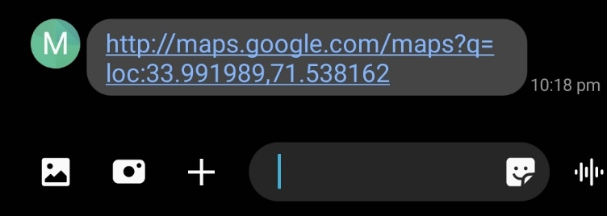
Collision Detection and Emergency Notification
As we install switches in the system to detect collision or accidents, which works like red flag, alerting the system to react as son as they detect an impact.
We install GSM module to send the notification to the specified contacts or emergency services if the accident happens.
Also we install the GPS module to determine the geographical location of the crash car that where is the accident happens.
Emergency Notification Message

Slide 13
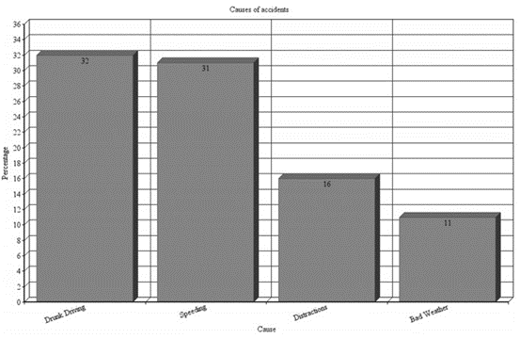
Causes of Accidents
The main cause of accidents is drunk driving which is 32%.
Second main cause of accidents is over speeding which is 31%.
The third cause of accidents include the distraction or drowsiness of the driver which is 16%.
The fourth cause of the accidents is the bad weather conditions which is 11%.
Causes of Accidents

Slide 14
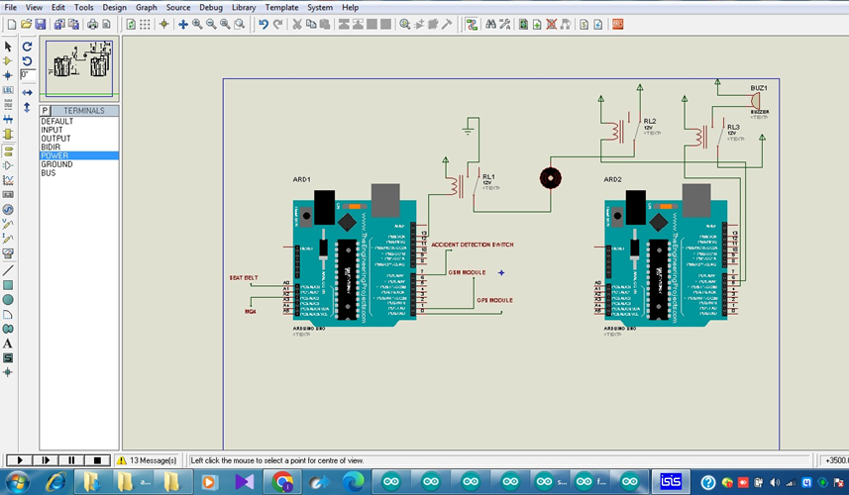
Hardware Circuit Diagram

Slide 15
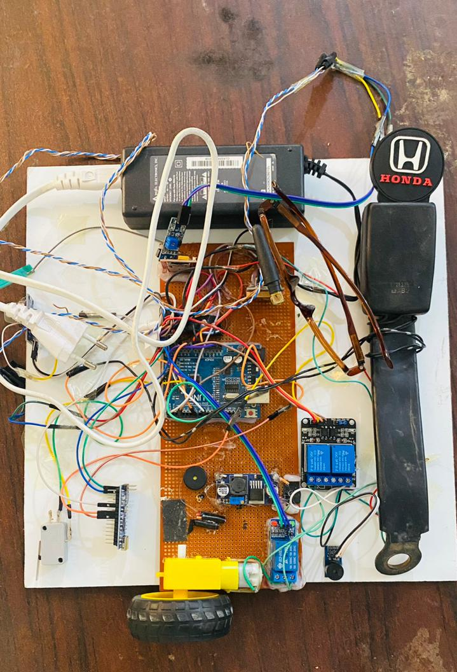
Hardware Prototype

Slide 16
Conclusion
Thus, we can conclude that the IoT-based smart vehicle security and safety system project aims to enhance comprehensive driver safety and vehicle security through real-time data monitoring and analysis.
Our objectives include, detection of seat-belt non-compliance, drunk driving avoidance, drowsiness detection and alert, and the collision detection and emergency notification.
We achieved the following two objective, i.e; detection of seat belt non-compliance and drunk driving avoidance in the first progress update.
In the second progress update we achieved the remaining two objectives which is drowsiness detection alert and the collision detection and emergency notification.
The future work includes enhanced real time data processing, comprehensive monitoring and improved the communication protocols.

Slide 17





THANK YOU

